Slide 1
Student Academic Performance Analysis
SUBMITTED BY:-
1.Ritik Agnihotri-524410011
2.Saksham chanouria-524410013
3.Anshul chauhan-524110020
4.Ashutosh diwedi-5244100

Slide 2
Introduction
The report titled “Student Academic Performance Analysis” offers a comprehensive study of undergraduate science students at the Central University of Allahabad, focusing on academic trends over the first and second years. Leveraging detailed datasets and tools like Python, Seaborn, Matplotlib, and Power BI, the analysis applies statistical techniques such as correlation analysis, hypothesis testing, and comparative assessments.
It explores key factors influencing performance, including the relationship between theory and practical marks, differences between university-enrolled and affiliated college students, and the impact of subject combinations like PMC and PMComp. The study provides data-driven insights and visualizations to support academic planning, highlight performance gaps, and inform effective interventions and policy decisions.

Slide 3
Data description
Attribute | Description | Data Type |  | Possible Values/Ranges
RollNo | Unique identifier for each student | Numeric |  | Integer values
EnrolNo | Enrollment Number (Same in entire course) | Text |  | Alphanumeric string, starts with 'U' for university students(U2112626-U2110241) and other alphabet for college students
Part1Total | Total marks in Part 1 (First Year) | Numeric |  | Range: 0 to Maximum Possible Marks(450), includes 'AA' (converted to NaN)
Part2Total | Total marks in Part 2 (Second Year) | Numeric |  | Range: 0 to Maximum Possible Marks(450), Includes 'AA' (converted to NaN)
GrandTotal | Sum of Part1Total and Part2Total | Numeric |  | Calculated field, sum of Part1Total(First Year) and Part2Total(Second Year). (Range: 0 to 900)
Result | Final result of the student | Categorical |  | 'Passed', 'Failed', 'Elig/SE' (Eligible for Supplementary Exam), 'Absent', 'AA'
Subject Columns | Marks in individual subjects (Physics, Mathematics, Chemistry, etc.) | Numeric |  | Range: 0 to Maximum Possible Marks for each subject. For Practical Subjects(Range: 0-50 for Practical and 0-33 for each theory exam) For Non-Practical Subjects(Range: 0-50 for each Theory exam)

Slide 4
Objectives
The academic performance of students is influenced by a wide range of factors—ranging from the type of institution they attend, to the subjects they choose, and even the presence of practical components in their curriculum. Understanding these influences is crucial not only for evaluating the effectiveness of current educational practices but also for shaping future academic strategies and student guidance mechanisms.

Slide 5
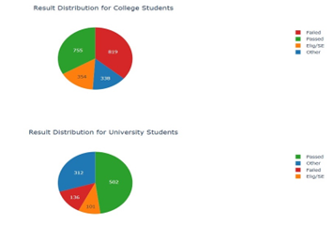
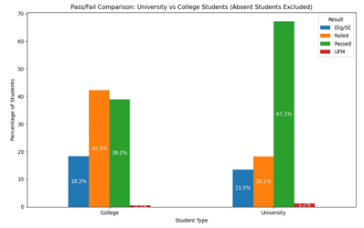
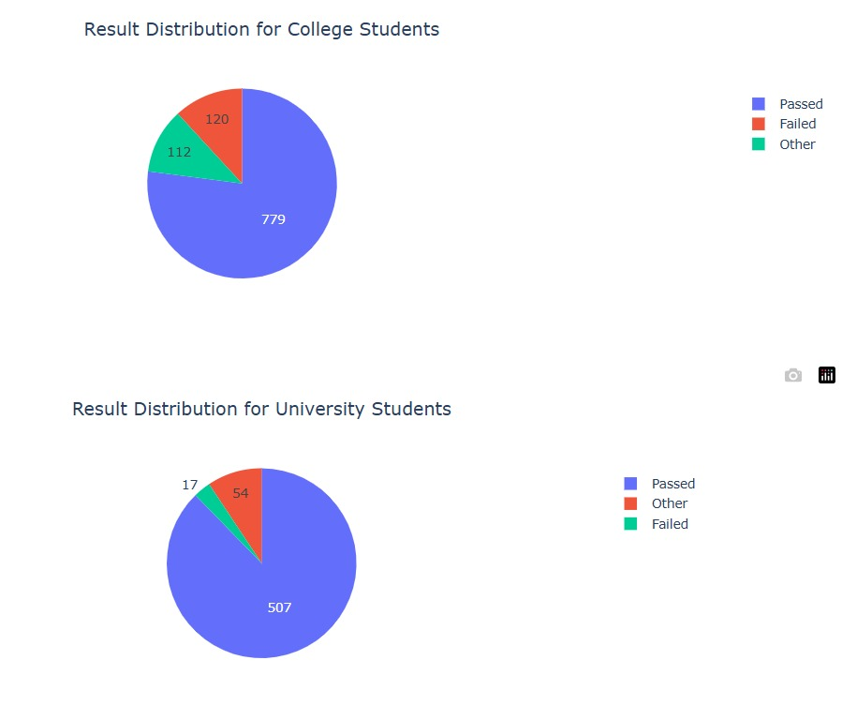
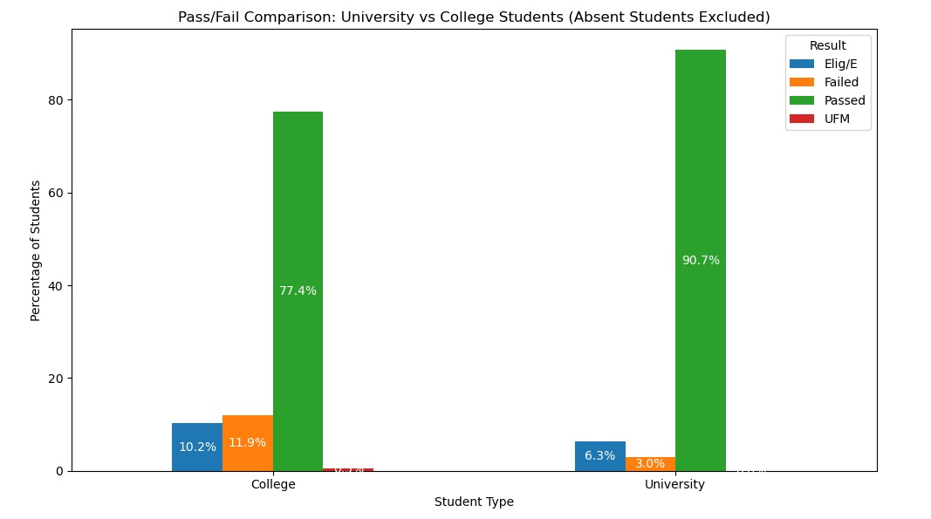
Q1. Determine if there's a statistically significant association between the institution type (university vs. affiliated college) and student pass/fail status

Slide 6
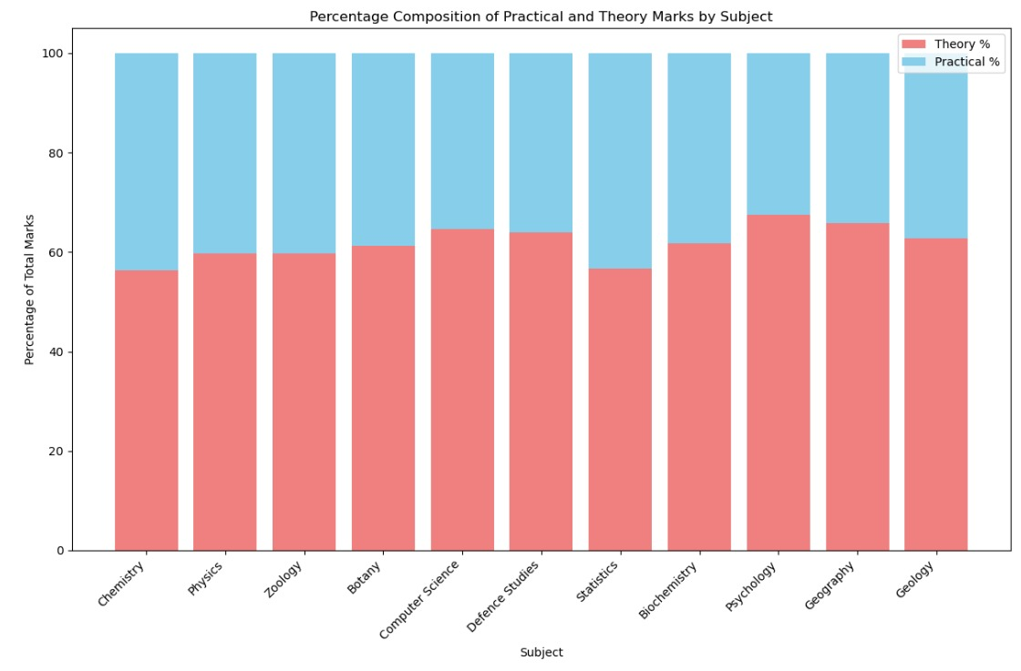

Q2. Does the inclusion of practical subjects in a student's curriculum influence their overall academic performance?

Slide 7
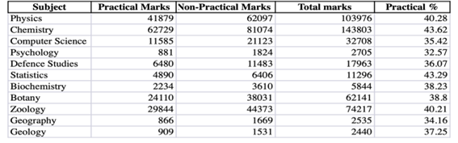
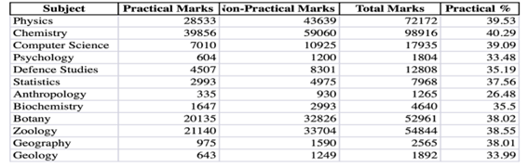
Q3. Is there a correlation between student performance in practical exams and their overall academic performance?

Slide 8
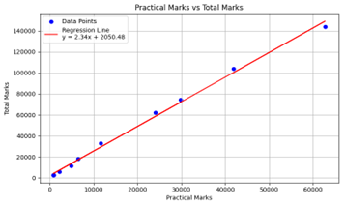
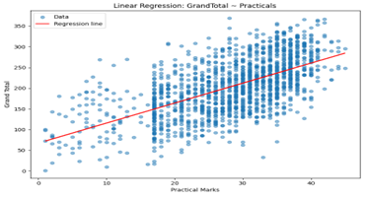
Pearson Correlation Coefficient: 0.9981
📊 P-value: 0.0000
✅ There is a statistically significant relationship between practical and total marks.

Slide 9
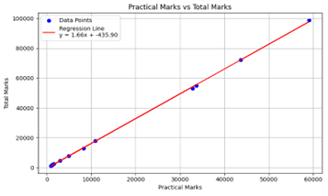
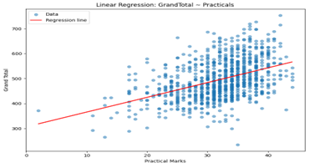
📈 Pearson Correlation Coefficient: 0.9998
📊 P-value: 0.0000
✅ There is a statistically significant relationship between practical and total marks.

Slide 10
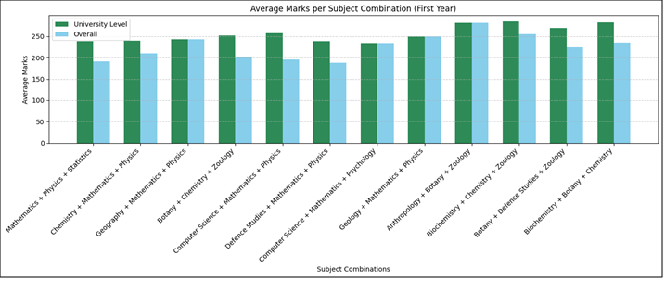
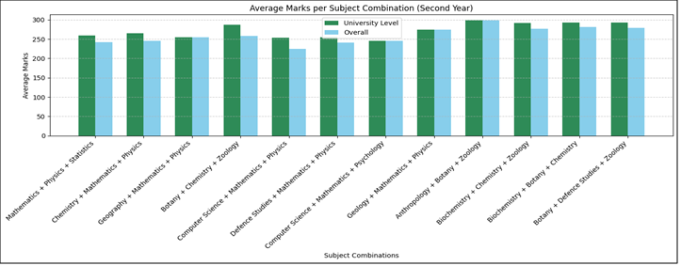
Q4. Determine whether the subject combination impacts the overall academic performance of the students across both University and Affiliated Colleges.

Slide 11
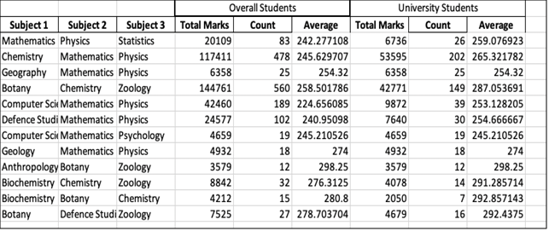
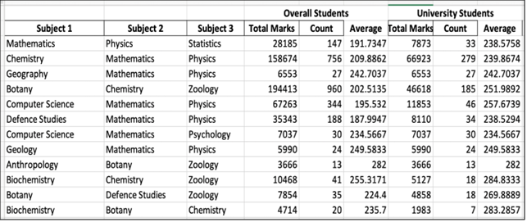

Slide 12
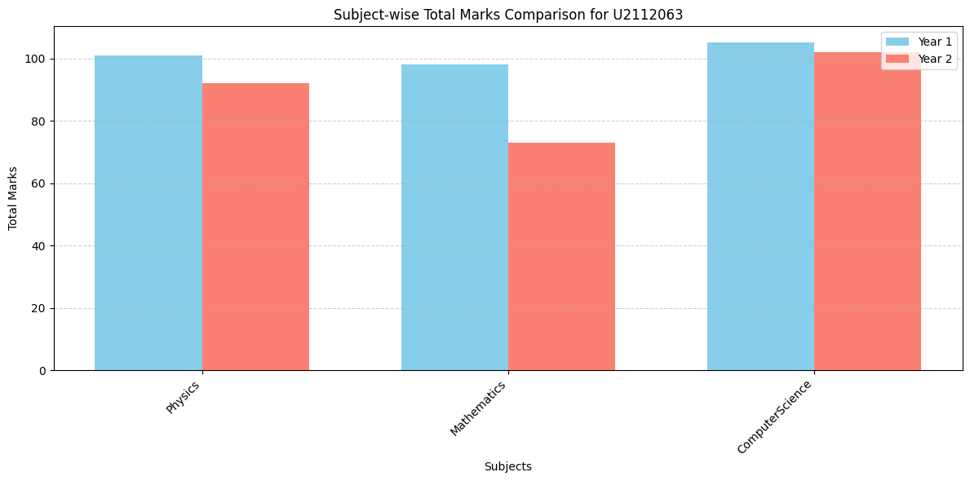
Q5. Which subject should a student drop in the third year based upon statistical analysis of the
past two years?

Slide 13
Hypothesis Testing 1: Verifying that a student’s result whether Pass/Fail depends upon the institution in which he/she is studying.
Null Hypothesis(Ho) : There is no relation between the result of student with the institute he is enrolled in. Alternate Hypothesis(H1) : There is significant relation between the result of student with the institute he is enrolled in.
Solution: For this, Chi-Square Test can be a better option for Inferential Statistics because we had categorical data such as (College-Passed, College-Failed, University-Passed, University Failed)

Slide 14
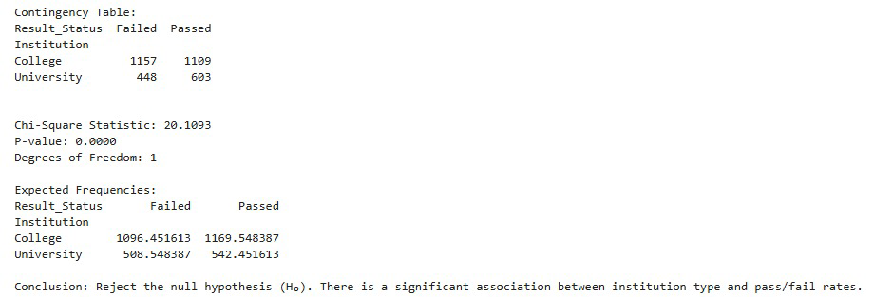
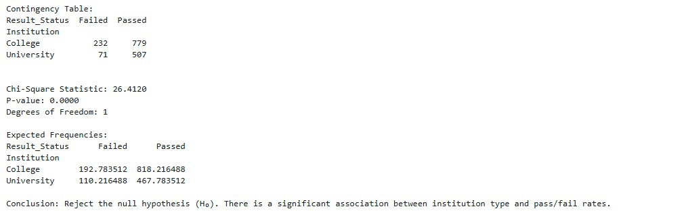

Slide 15
Hypothesis Testing 2: Verifying that a student’s result aggregate is affected by his/her subject combination choice.
Null Hypothesis(Ho) : There is no relation between the result of student with the subject combination he has choosen.
Alternate Hypothesis(H1): There is a significant relation between the result of student with the subject combination he has choosen
Solution: For this, Chi-Square Test can be a better option for Inferential Statistics because we had categorical data such as (‘Subject Combination’-‘Result Type’)

Slide 16
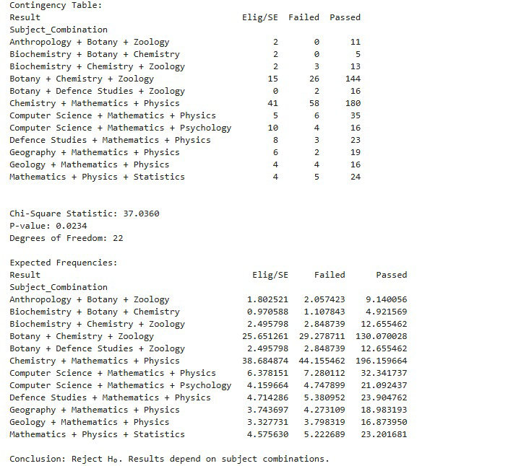
1st Year

Slide 17
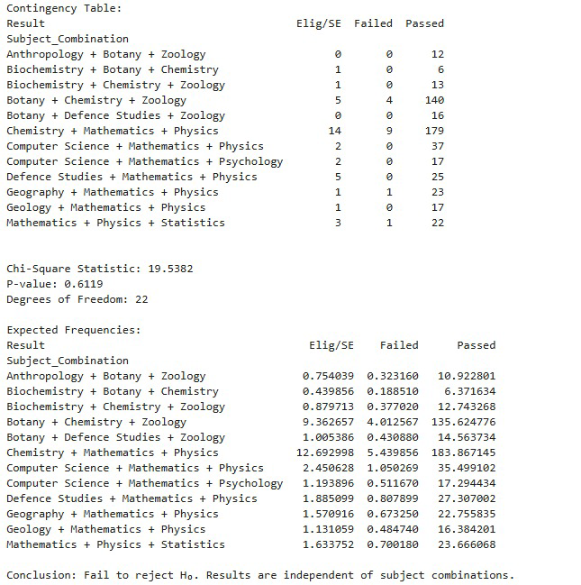
2nd year

Slide 18
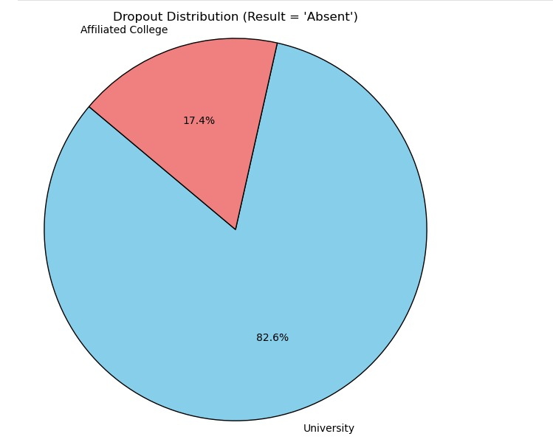
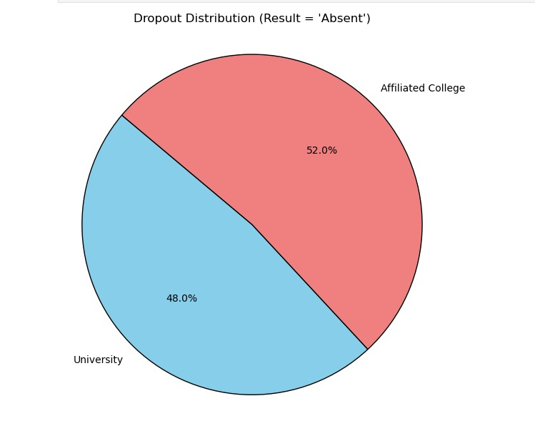
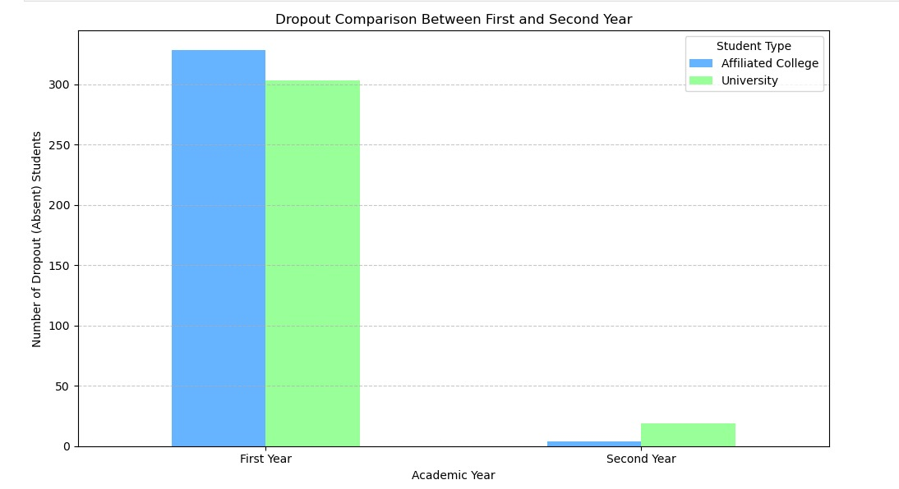

Slide 19
CONCLUSION
Student Academic Performance Analysis – Summary
This project analyzed academic trends among undergraduate science students at the Central University of Allahabad using statistical methods and data visualization. Key findings include:
Practical exam performance strongly correlates with overall academic success, highlighting the value of hands-on learning.
University students generally outperformed those from affiliated colleges, suggesting disparities in teaching quality and resources.
Subject combinations impact student outcomes, helping guide subject selection decisions based on past performance.
The analysis supports data-driven planning, aiding students, educators, and institutions in improving academic outcomes and resource allocation.

Slide 20
REFERENCES:-
Data description:-
Source: https://allduniv.ac.in/files/result/NET_BSc2_2022-23.pdf
Chat GPT:Chatgpt.com

Slide 21
Thank you

